Slide 1
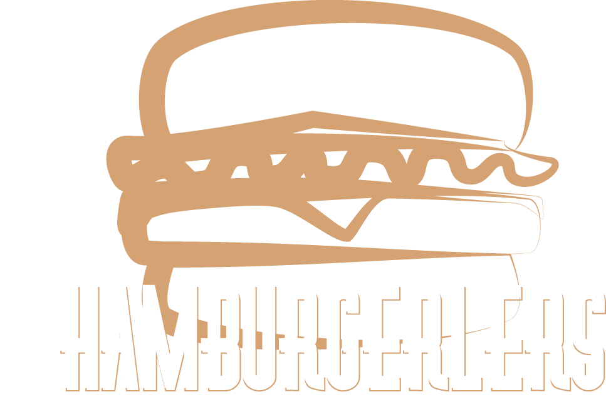
Kevin Haro: Team Lead
Jonathan Hammond: UX
Luis Garcia: Design
Alec Michel: Documentation
Client: Ammar Shallal
Faculty Advisor: Dr. Jim Schwing

Slide 2
Overview
Process Model
Problem
Solution
Requirements
Prototype
QA & Risk Analysis
Conclusion

Slide 3
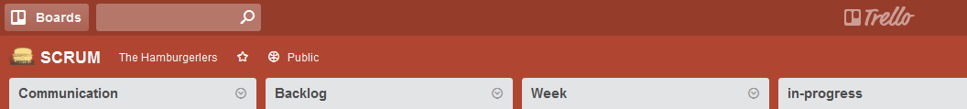
Process model
Agile - SCRUM
leveraging Trello + kanban
Scrum meetings: Mon, Wed, Fri
discuss work completed, hurdles, future tasks
Group collaborative work: Fri and whenever needed
discuss weekly planning and assessment
client communication
resolve impediments

Slide 4
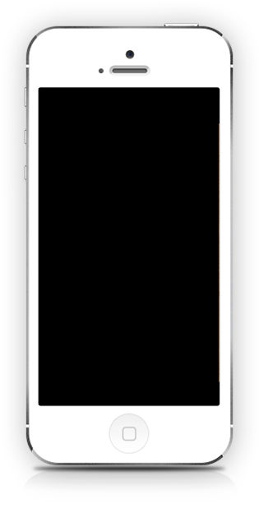
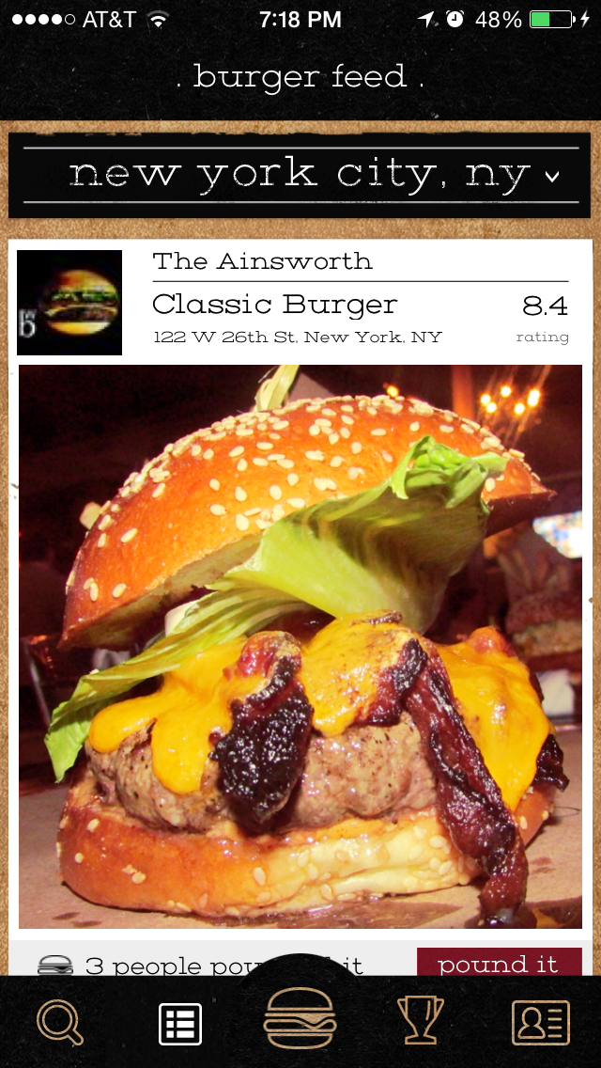
Problem
Client’s app, Burgerator, only available for iOS
Client need:
an Android version of app to increase accessibility.
Client want:
add social features
allow user to browse app without account
capture location data when app is opened
notifications
database redesign

Slide 5

Solution
Primary:
review iOS source, server API, and 3rd party APIs (Yelp, Facebook, Twitter)
Iterate weekly to develop an Android port of Burgerator
Secondary:
continue iterations, work towards Burgerator 2.0
allow non-registered users to browse app
add social features: comments, follows, deals
redesign database to focus on
Yes!

Slide 6

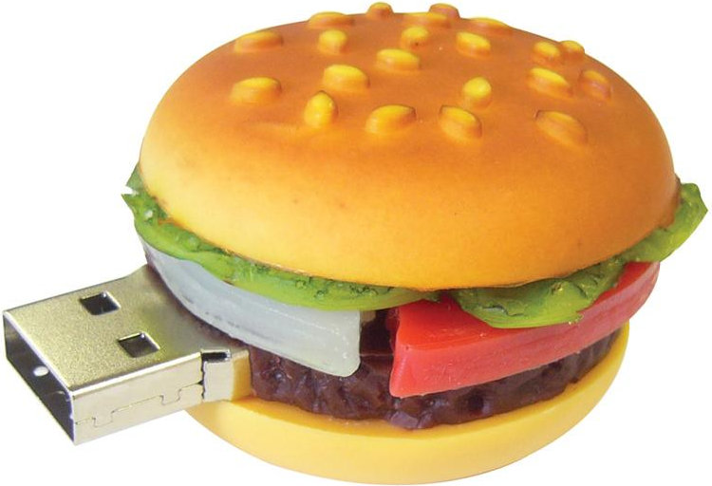




Project Requirements
Replicate iOS in Android
- Replicate existing iOS UI
- Connection to existing database
- Connect to Yelp API
- Allow location services
- Allow user login

Slide 7
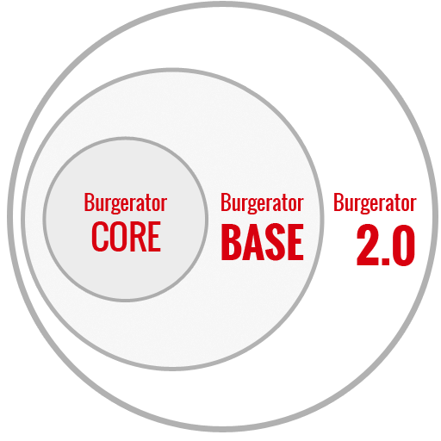
Requirements - Proposed Burgerator Systems
Primary: Develop Core + Base
Secondary: Develop 2.0

Slide 8
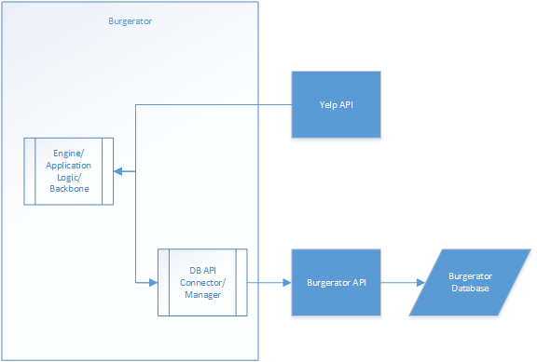
Requirements - Core System
Backbone
API’s
DB

Slide 9
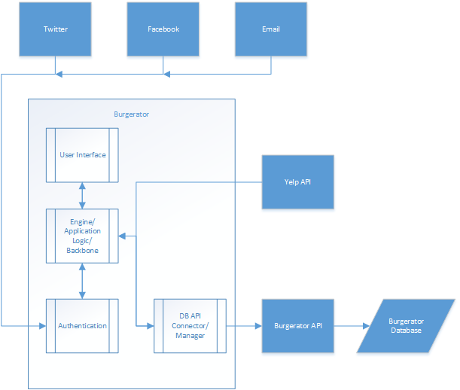
Requirements - Base System
Replicate iOS

Slide 10



Non-functional Requirements
User location input
Location in real time
Database Scalability and Extensibility
Query the database in realtime

Slide 11
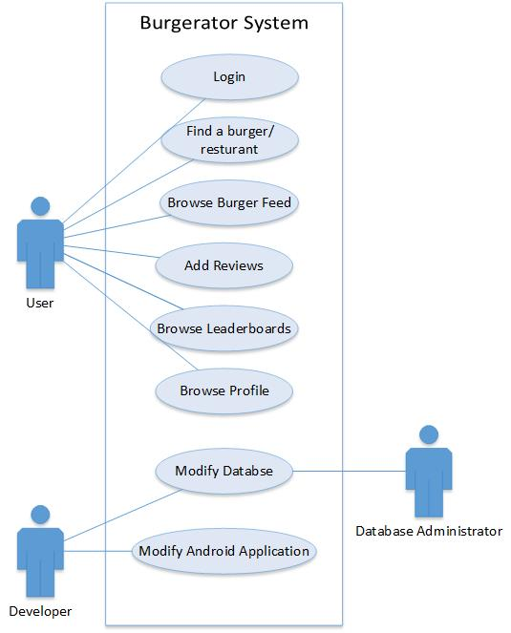
Functional Requirements
Satisfy all use cases

Slide 12
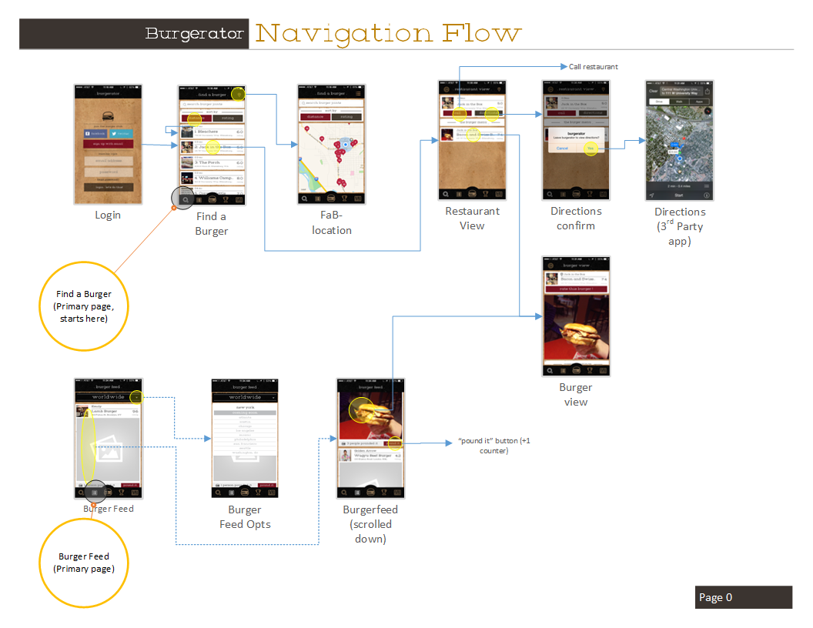
Prototype
Navigation flow
(1st page)

Slide 13
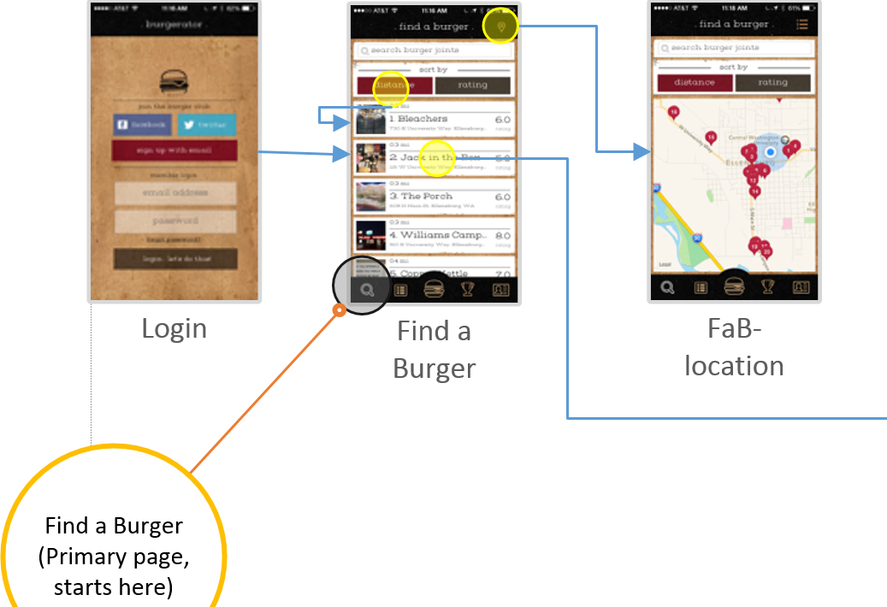
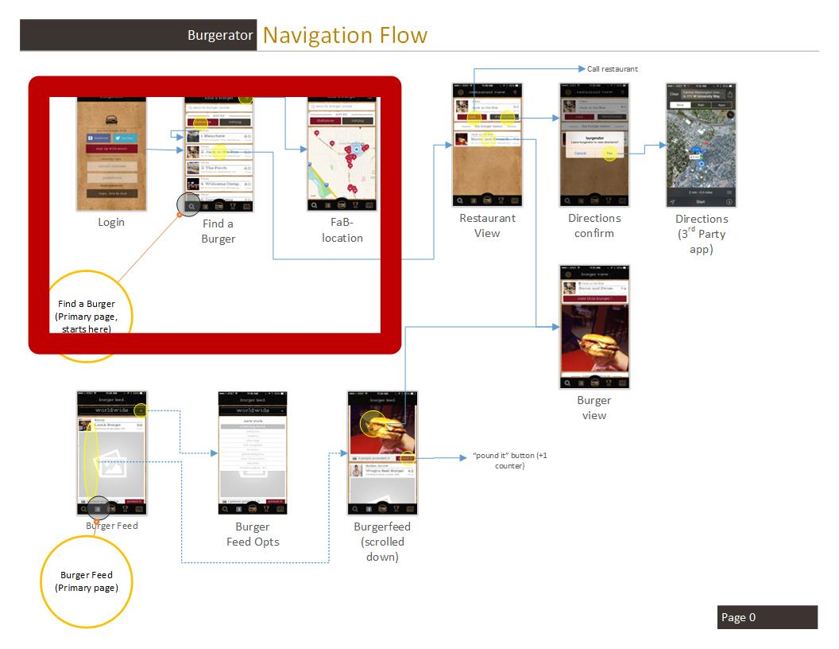
Prototype

Slide 14
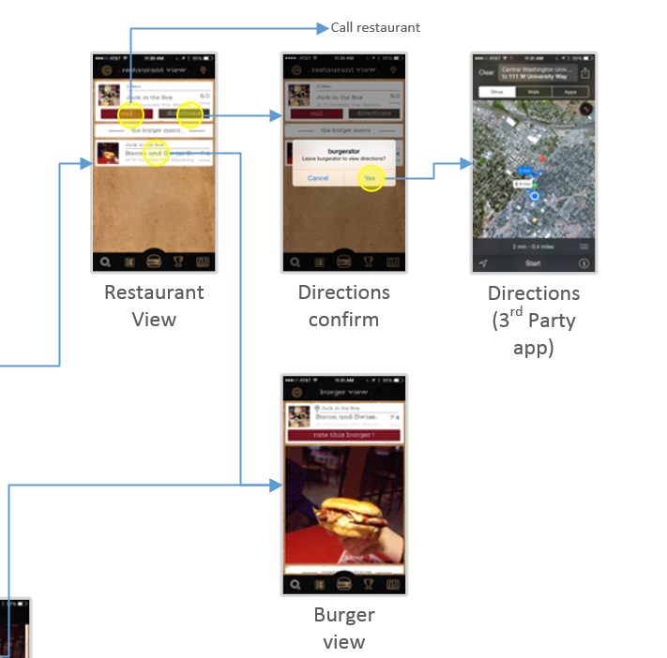
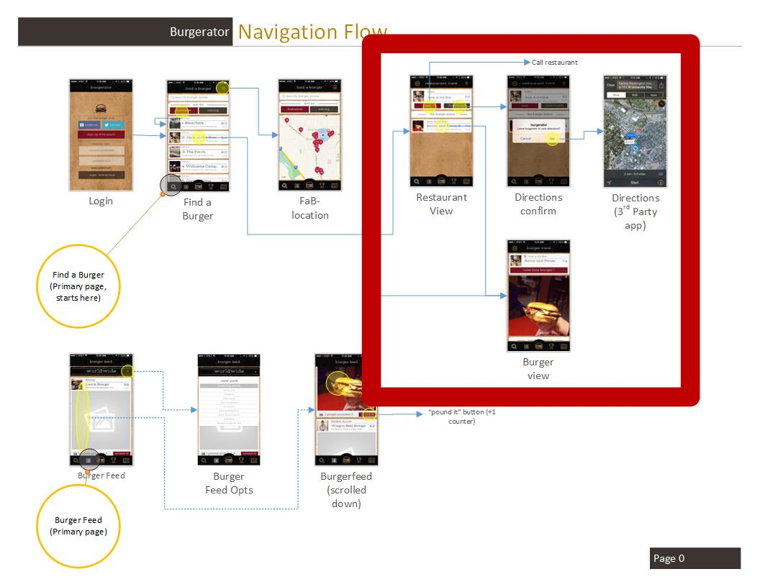
Prototype

Slide 15
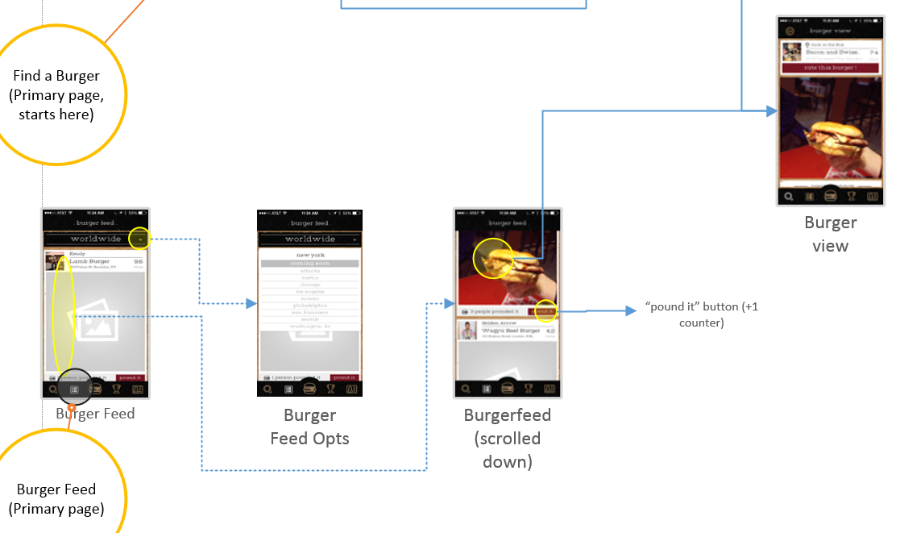
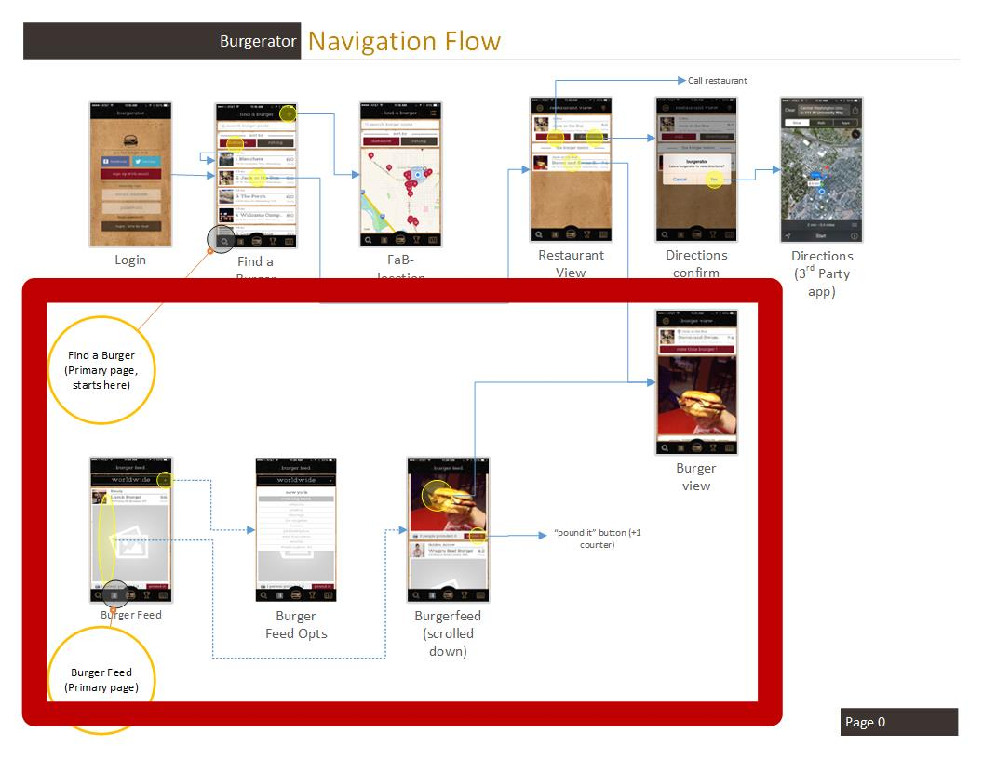
Prototype

Slide 16


Quality Assurance
Client Feedback
Requests Updates and Questions
Consistent Contact and Communication
Satisfied with Responses
Debugging Tools
Android Studio
Virtual and hardware mobile devices
Testing
Android unit testing platform,
Virtual and hardware mobile devices

Slide 17
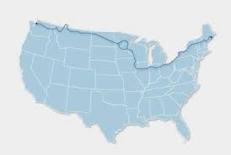
Risk and Strategies Analysis
Risks
Distance: client lives in New York
Total scope of project (including wants)
Cost risk to client of failure to deliver

Slide 18






Risk and Strategies Analysis cont.
Strategies
Use of project organization tools
Consolidation of communication to client
Consulting our faculty mentor regarding roadblocks
Agile SCRUM: daily meetings, weekly accountability

Slide 19
Conclusion
Client needs iOS app to be made for Android
Team Hamburgerlers tasked to develop Android port of Burgerator iOS app
Requirements, High-level design, and APIs researched
Prototype of navigation flow
QA and Risk Analysis complete
“Burger on!” - Ammar Shallal

Slide 20
Questions and Comments

